Slide 1
RDCH 702: Lecture 5 Nuclear Force, Structure and Models
Readings:
Nuclear and Radiochemistry: Chapter 10 (Nuclear Models)
Modern Nuclear Chemistry: Chapter 5 (Nuclear Forces) and Chapter 6 (Nuclear Structure)
Characterization of strong force
Charge Independence
Introduce isospin
Nuclear Potentials
Simple Shell Model (Focus of lecture)
Nuclear Force
For structure, reactions and decay of nuclei
electromagnetic, strong and weak interactions are utilized
Fundamental forces exhibit exchange character
operate through virtual exchange of particles that act as force carriers

Slide 2
Strong Force
Nuclear force has short range
Range of a nucleon
Nuclear force is strongly attractive and forms a dense nucleus
Nuclear force has a repulsive core
Below a distance (0.5 fm) nuclear force becomes repulsive
Force between two nucleons has two components
spherically symmetric central force
asymmetric tensor force
Spin dependent force between nucleons
Consider ²H
Proton and neutron
Parallel spin ³S
Can be in excited state, ³D
Antiparellel is unbound ¹S

Slide 3
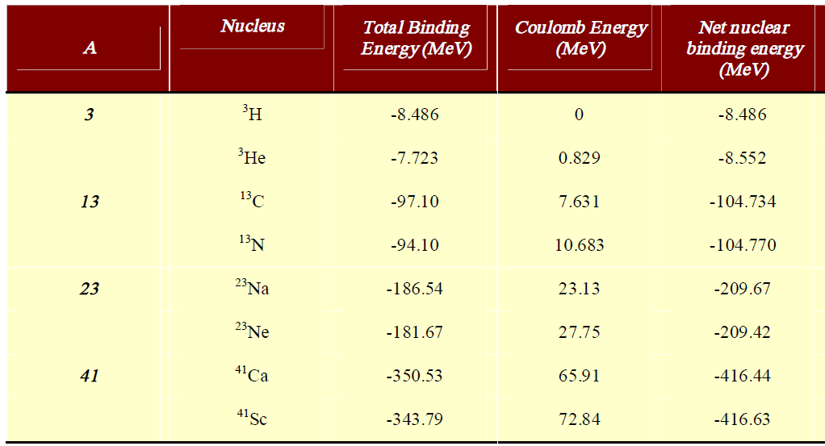
Charge Independent Force
Strong force not effected by charge
np, nn, pp interactions the same
Electromagnetic force for charge
Strong force examined by
Nucleon-nucleon scattering
Mirror nuclei
Isobars with number of p in one nuclei equals number of n in other
Similar energy for net nuclear binding energy
Normalize influence of Coulomb Energy
Shows proton and neutron two states of same particle
Isospin is conserved in processes involving the strong interaction
Isospin forms basis for selection rules for nuclear reactions and nuclear decay processes
Property of nucleon
Analogy to angular momentum
T=1/2 for a nucleon
+1/2 for proton, -1/2 for neutron

Slide 4
Nuclear Potential Characteristics
Particles in a potential well
Nuclear forces describe potential
Small well
Well stabilizes nucleons
Free neutrons decay
Neutrons can be stable in nuclear well
Mixture of nucleons stable
2 protons (²He) unstable
2 neutrons unstable
A=3
Mixture of n and p stable
3 protons unstable
Nuclear force acts between nucleons in uniform way
Protons have additional Columbic repulsion that destabilize proton-rich nuclei
Very neutron-rich nuclei are also unstable
Light, symmetric nuclei (Z=N) are favored
Nuclear force depends on the spin alignment of nucleons
Potential energy of two nucleons shows similarity to chemical bond potential-energy function

Slide 5
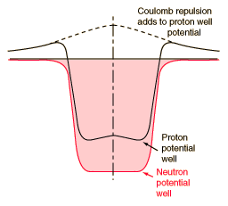
Shell Model
Interactions among nucleons in nucleus replaced by potential-energy well within which each particle moves freely
Properties determined by shape of potential energy well
Experimental Evidence to support model
ground-state spin of 0 for all nuclei with even neutron and proton number
Magic number for nuclei
Systematics of ground-state spins for odd-mass-number nuclei
Dependence of magnetic moments of nuclei upon their spins
Properties of ground states of odd-mass-number nuclei approximately from odd, unpaired nucleon
All other nucleons provide potential-energy field
determines single-particle quantum states for unpair nucleon
Stability of nuclei based on number of neutrons and protons

Slide 6
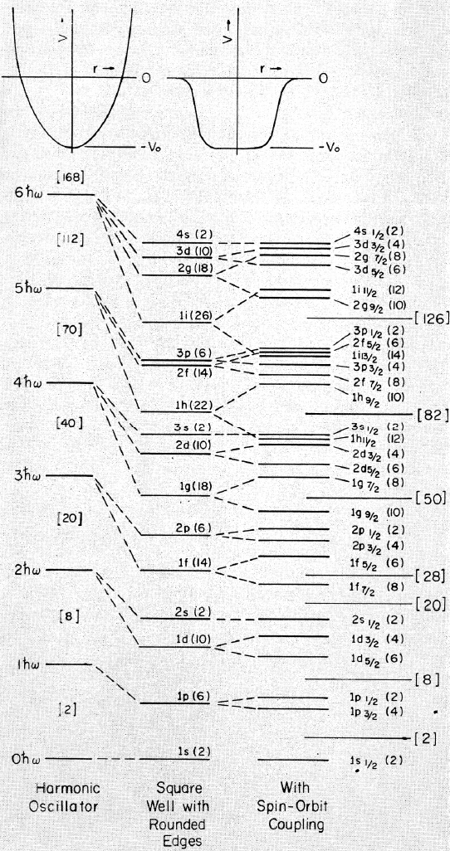
Shell Model
Model nucleus as a spherical rigid container
square-well potential
potential energy assumed to be zero when particle is inside walls
Particle does not escape
Harmonic oscillator potential
parabolic shape
steep sides that continue upwards
useful only for the low-lying energy levels
equally spaced energy levels
Potential does not “saturate”
not suitable for large nuclei
Change from harmonic oscillator to square well lowers potential energy near edge of nucleus
Enhances stability of states near edge of nucleus
States with largest angular momentum most stabilized

Slide 7
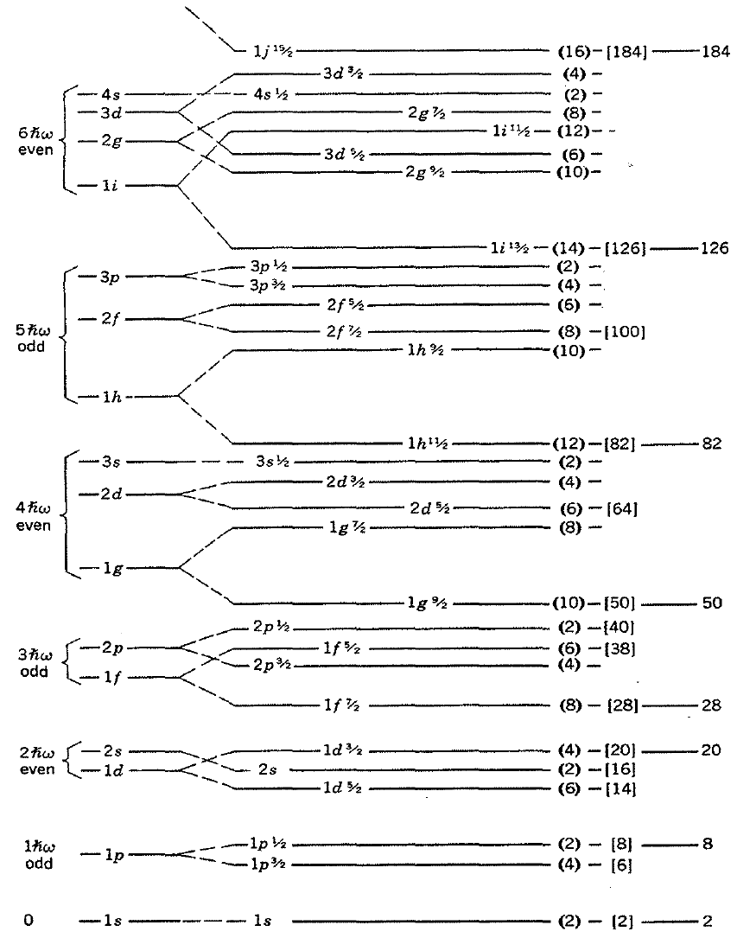
Shell Model
Shell filling
States defined by n and l
1s, 1p, 1d, …
Compare with electrons
States with same 2n+l degenerate with same parity (compose level)
2s = 2*2+0=4
1d = 2*1+2 =4
1g=2*1+4=6
2d=2*2+2=6
3s=2*3+0=6
Spin-Orbit Interaction
Addition of spin orbit term causes energy level separation according to total angular momentum (j=ℓ+s)
For p, l=1
s=±1/2
j= 1+1/2=3/2 and 1-1/2=1/2
split into fourfold degenerate 1p_{3/2} and twofold degenerate 1p_{1/2} states
For g, l=4, j=7/2 and 9/2
states with parallel coupling and larger total angular momentum values are favored
closed shells 28, 50, 82, and 126
splitting of the 1f, 1g, 1h, and 1i
Each principal quantum number level is a shell of orbitals
Energy gap between shell the same

Slide 8
Filling Shells
Odd-A Nuclei
In odd A nucleus of all but one of nucleons considered to have their angular momenta paired off
forming even-even core
single odd nucleon moves essentially independently in this core
net angular momentum of entire nucleus determined by quantum state of single odd nucleon
Spin of spin of state, parity based on orbital angular momentum
Even (s, d, g, i,….)
Odd (p, f, h,….)
Configuration Interaction
For nuclides with unpaired nucleons number half way between magic numbers nuclei single-particle model is oversimplification
Contribution from other nucleons in potential well, limitation of model
Odd-Odd Nuclei
one odd proton and one odd neutron each producing effect on nuclear moments
No universal rule can be given to predict resultant ground state
Level Order
applied independently to neutrons and protons
proton levels increasingly higher than neutron levels as Z increases
Coulomb repulsion effect
order given within each shell essentially schematic and may not represent exact order of filling
Ground States of Nuclei
filled shells spherically symmetric and have no spin or orbital angular momentum and no magnetic moment
ground states of all even-even nuclei have zero spin and even parity
increased binding energy of nucleons

Slide 9
Filling Shells
lowest level is 1s_{1/2},
s since ℓ=0, j=ℓ+s=1/2
level has only 2ℓ+1=1 m-value
hold only 2 protons in proton well and two neutrons in neutron well
next levels are 1p_{3/2} and 1p_{1/2} pair
N=1 ħω
⁴He exact filling of both N=0 harmonic oscillator shells for neutrons and protons
expected to have an enhanced stability
Consider shell filling when N=0 ħω and N=1 ħ ω shells filled
eight protons and eight neutrons
¹⁶O should be especially stable
other shell closures occur at 20, 28, 50, 82, and 126 nucleons
unusually large numbers of isotopes and isotones due to enhanced stability
A few stable nuclei have both closed neutron and proton shells
very strongly bound (relative to their neighbors)
⁴He, ¹⁶O, ⁴⁰Ca, ⁴⁸Ca, and ²⁰⁸Pb
doubly closed shell nuclei have been synthesized outside stable range
⁵⁶Ni, ¹⁰⁰Sn and ^{l32}Sn (unstable)

Slide 10
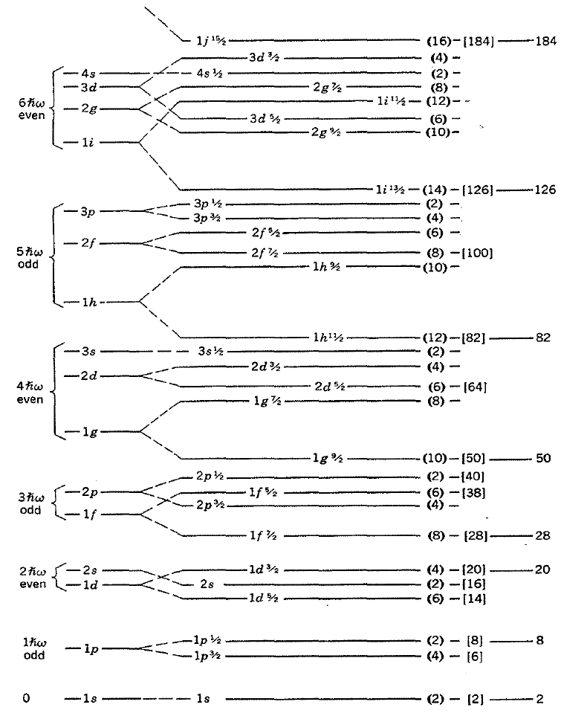
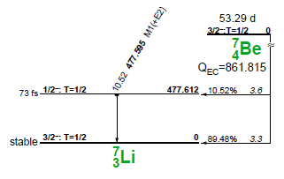
Filling Example
Consider isotope ⁷Li
3 protons and 4 neutrons
2 protons in 1s_{1/2}, 1 proton in 1p_{3/2}
2 neutrons in 1s_{1/2}, 2 neutrons in 1p_{3/2}
spin and angular momentum based on unpaired proton
spin should be 3/2
nuclear parity should be negative
parity of a p-state (odd l value, l=1)
Excited state for ⁷Li?
Proton from 1p_{3/2} to 1p_{1/2}
Breaking paired nucleons requires significant energy, neutrons remain paired
Bound excited state corresponds to promotion of proton
1p_{1/2} corresponds to 1/2-

Slide 11
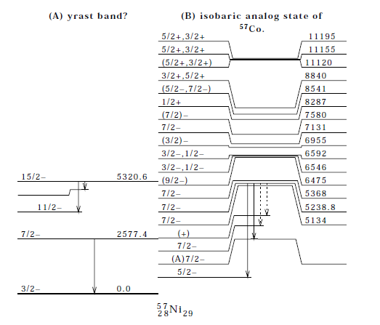
Filling Example
Consider ⁵⁷Ni
28 protons, 29 neutrons
Protons fill to 1f_{7/2}, all paired
Single neutron in 2p_{3/2}
3/2– spin and parity
Excited state of ⁵⁷Ni
From 2p_{3/2} to 1f_{5/2}

Slide 12
Filling Levels
consider ¹³C
7th neutron is unpaired
p ½ state
½-
⁵¹V unpaired nucleon is 23rd proton, f 7/2
7/2-
Not always so straight forward
examine ¹³⁷Ba
81st neutron is unpaired, h 11/2
spin 11/2-
measured as 3/2+
high spin does not appear as ground
Deformation impacts level filling

Slide 13
Shell Filling: Spin and parity for odd-odd nuclei
Configurations with both odd proton and odd neutron have coupling rules to determine spin
Integer spin value
Determine spin based on Nordheim number N
Nordheim number N (=j₁+j₂+ l₁+ l₂) is even, then I=⎢j₁-j₂⎢
if N is odd, I=⎢j₁±j₂⎢
Parity from sum of l states
Even positive parity
Odd negative parity
prediction for configurations in which there is combination of particles and holes is I=j₁+j₂-1
Examples on following page

Slide 14
Shell Model Example
Consider ³⁸Cl
17 protons (unpaired p in 1d_{3/2})
l=2 (d state) and j=3/2
21 neutrons (unpaired n in 1f_{7/2})
l=3 (f state) and j=7/2
N= 2+3/2+3+7/2 = 10
Even; I=⎢j₁-j₂⎢
Spin = 7/2-3/2=2
Parity from l (3+2)=5 (odd), negative parity
2-
Consider ²⁶Al (13 each p and n)
Hole in 1d_{5/2}, each j = 5/2, each l=2
N=5/2+5/2+2+2=9
N=odd; I=⎢j₁±j₂⎢
I = 0 or 5 (5 actual value)
Parity 2+2=4, even, +
5+

Slide 15
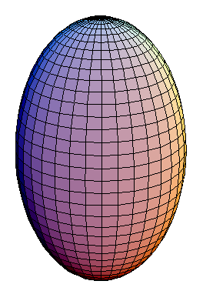
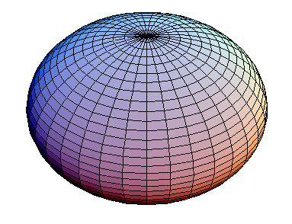
Particle Model: Collective Motion in Nuclei
Effects of interactions not included in shell-model description
pairing force
lack of spherically symmetric potential
Nonspherical Potential
intrinsic state
most stable distribution of nucleons among available single-particle states
since energy require for deformation is finite, nuclei oscillate about their equilibrium shapes
Deformities 150 <A<190 and A<220
vibrational levels
nuclei with stable nonspherical shape have distinguishable orientations in space
rotational levels
polarization of even-even core by motion of odd nucleon
Splitting of levels in shell model
Shell model for spherical nuclei
Deformation parameter ε₂
Prolate: polar axis greater than equatorial diameter
ΔR=major-minor axis
Prolate ΔR is positive
Oblate ΔR is negative
Oblate: polar axis shorter than diameter of equatorial circle

Slide 16
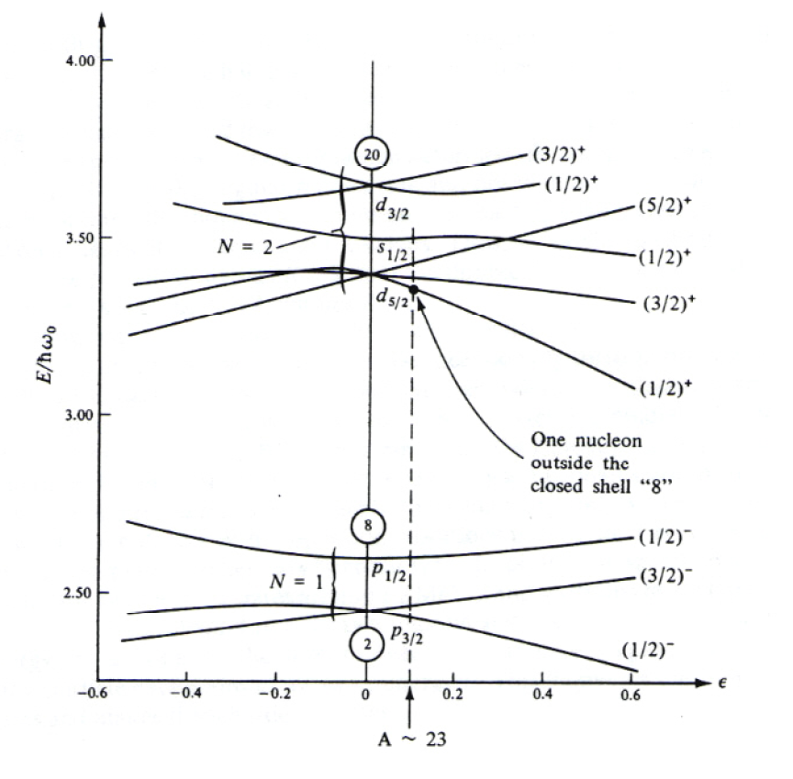
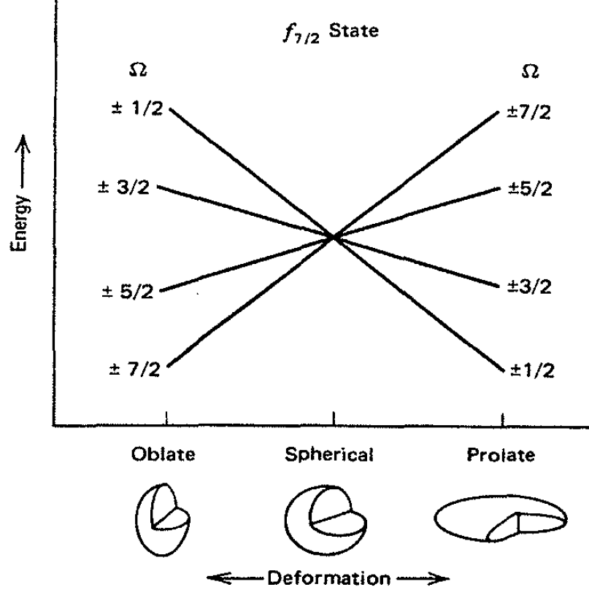
Shell change with deformation
Energy of a single nucleon in a deformed potential as a function of deformation ε.
diagram pertains to either Z < 20 or N < 20. Each state can accept two nucleons
f_{7/2} deformation

Slide 17
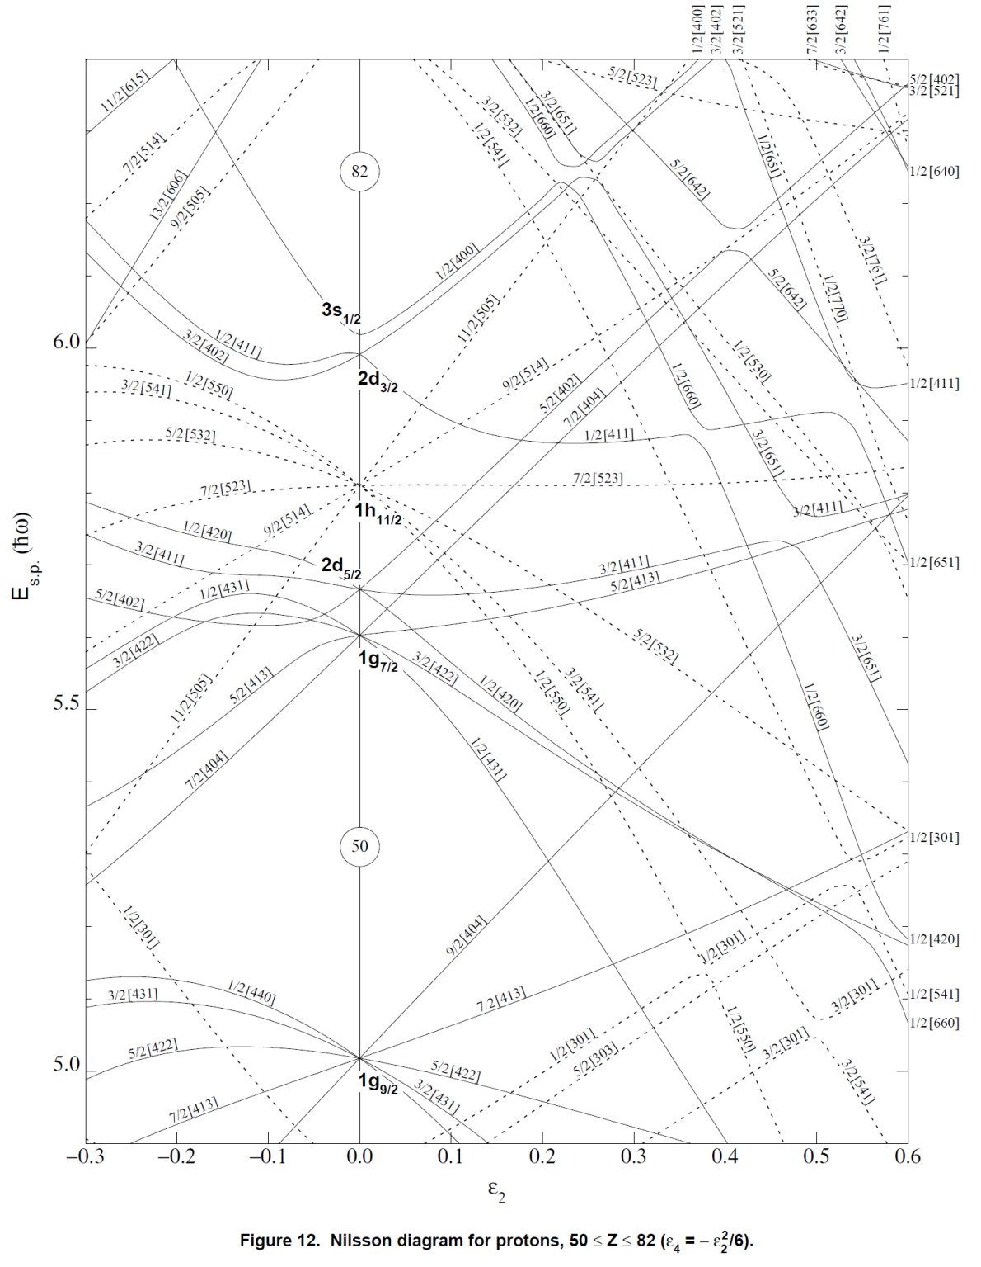
Nilsson Diagram
50<Z<82
¹²⁷I
53rd proton is unpaired
7/2+ from shell model
measured as 5/2+
Deformation parameter should show 5/2, even l
Oblate nuclei

Slide 18
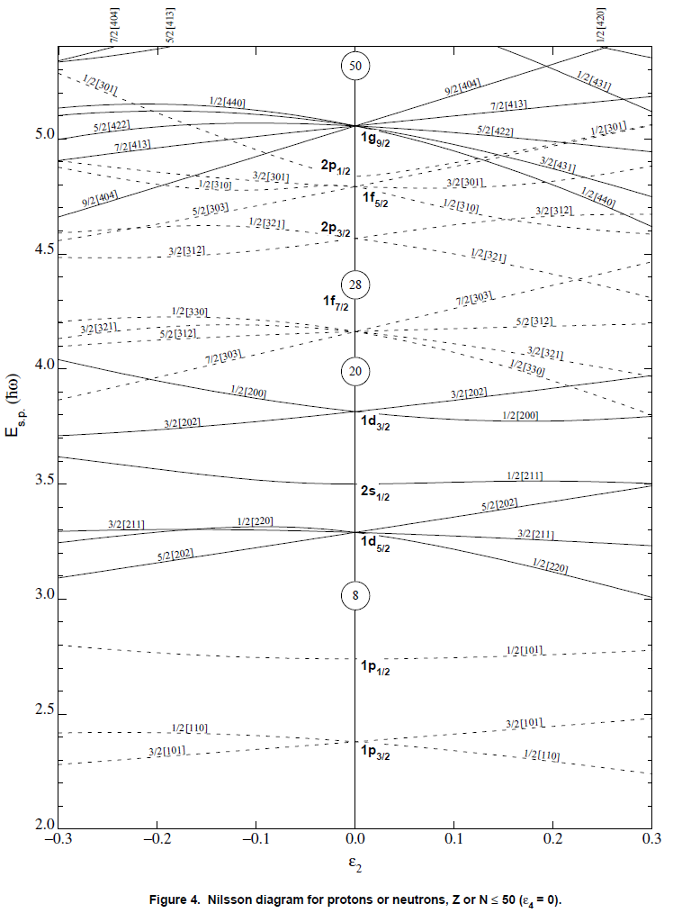
Consider for K isotopes
Which K odd A isotope may be non-spherical?
Z=19
⁴⁷K ½+

Slide 19
Questions
What is a nuclear potential
What are the concepts behind the shell model
What can be inferred from deviations in spin and parity from the shell model?
How do nuclear shapes relate to quadrupole moments

Slide 20
Pop Quiz
Provide comments on blog
Respond to PDF Quiz 5

